Slide 1
Group 2
IronKaggle Project
Predicting Shop Sales Using Regression Models
Team Members:
Bader - Hessa - Randa - Abdulaziz

Slide 2

Project Definition
Summry: The goal of this project is to predict sales figures using various regression models. By evaluating multiple machine learning models, we aim to identify the model that provides the most accurate sales predictions.
Problem Statement
How can we accurately predict sales using machine learning?
Objective
Develop a machine learning model to predict accurate sales.
Evaluate the model's performance, with a target R² value to indicate accuracy.

Slide 3
Scope of the Project
1
Roles & Responsibilites
At the start, we collaborated on building a Linear Regression model to understand the data and establish a baseline. Then, we divided the models among team members for further experimentation:
Bader –ExtraTrees, XGBoost
Randa – CatBoost
Hessa – LightGBM
Aziz – Random Forest
2
Workflow & Steps
Initial Collaboration
Model Distribution
Evaluation & Comparison
Final Best performance model : The chosen model was fine-tuned further for better accuracy.
3
Deliverables
Project to be submitted by 6 PM Sunday.
Final model with optimized hyperparameters.
Evaluation report with insights and recommendations.

Slide 4







Prototype different models
We started off by Building and Testing multiple machine learning models to compare their final performance.
A powerful gradient boosting model that has become popular for its speed and accuracy in regression tasks.
A gradient boosting method particularly effective with categorical features, providing strong performance with minimal tuning.
A gradient boosting method optimized for speed and efficiency, widely used for large datasets.
An ensemble learning method that builds multiple decision trees to improve predictive performance. An approach to reduces variance and improves generalization while maintaining efficiency.
A simple yet powerful statistical method used for predicting a continuous target variable based on one or more independent variables.
It constructs multiple decision trees and combines their predictions to improve accuracy and reduce overfitting. It works by randomly selecting subsets of data and features for each tree, averaging their outputs
RandomForest

Slide 5
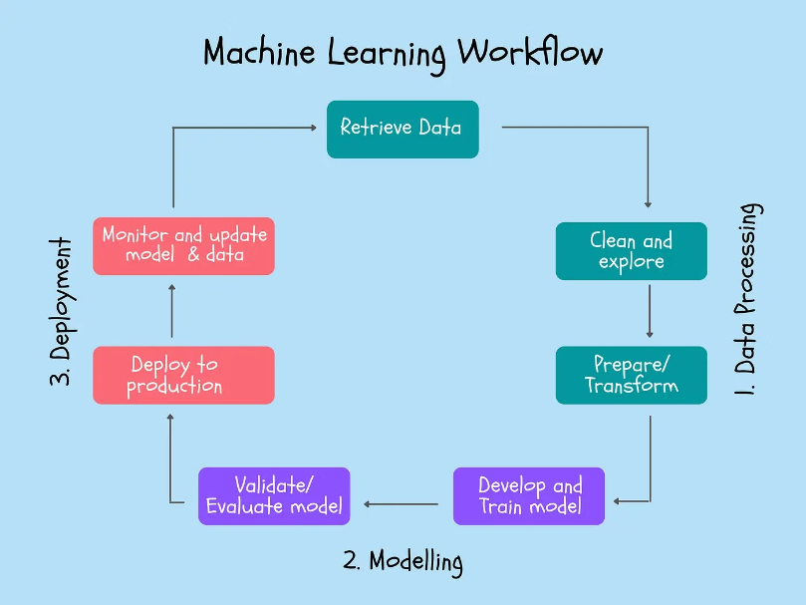
End To End Machine Learning
———Project WorkFlow———

Slide 6

Methodology:
Data Preprocessing
Modelling
Evaluation
Comparison Data
Future Enhancements
Conclusion

Slide 7
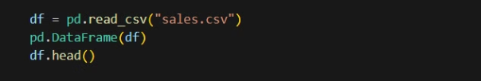
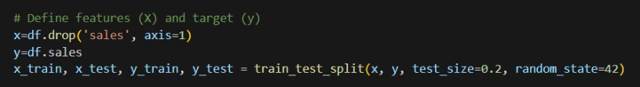
Sales file:
1
Data Preprocessing:
We started by loading the dataset using Pandas
Feature selection followed, where we defined X as the independent variables and y as the target variable (sales).
2
Data cleaning
We removed irrelevant columns such as Unnamed: 0, date, state_holiday, school_holiday, and day_of_week, as they did not contribute significantly to our sales predictions. based on the co matrix
3
Data Splitting
We split the dataset into training (80%) and testing (20%) sets using train_test_split()

Slide 8

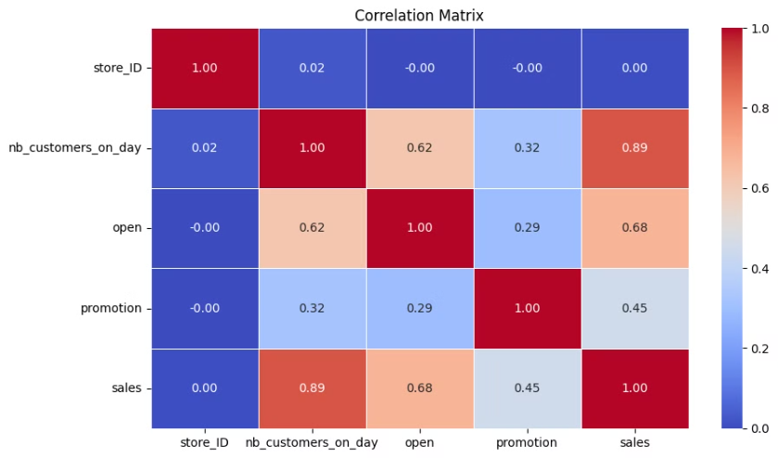
Pre processing: Performance Metrics
Correlation Matrix

Slide 9
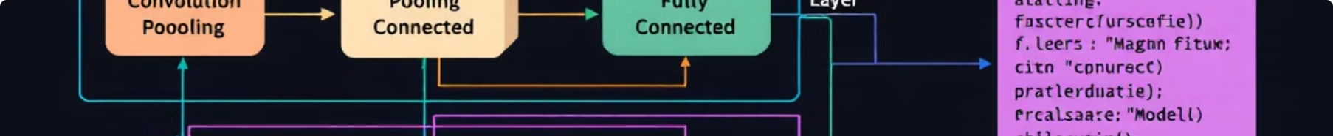


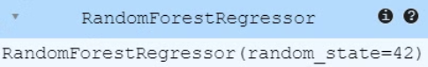

Modelling - Random Forest Regressor Model
Model Selection
First, We selected a Suitable Model
Algorithim selection: Random Forest Regressor
Model Training
The method has been used is fitting:
Model Optimization
HyperParameters:
n_estimators=100: Number of decision trees in the forest
random_state=42: Ensures reproducibility of results

Slide 10
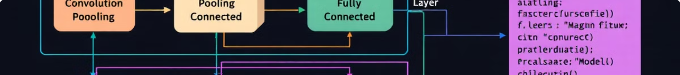


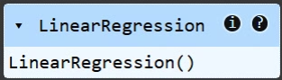

Modelling - Linear Regressor Model
Model Selection
Algorithim selection:Linear Regressor
Model Training
The method has been used is fitting:
Model Optimization
Tune Hyperparameters

Slide 11


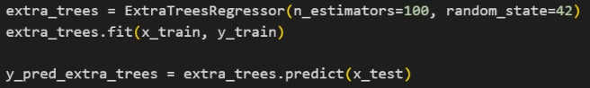

Modelling - ExtraTrees regressor Model
Model Selection
Algorithim selection: ExtraTree regressor
Parameters:
n_estimators=100: Number of decision trees in the forest
random_state=42: Ensures reproducibility of results
Model Training
The method has been used is fitting:
Model Optimization
HyperParameters:
n_estimators=100: Number of decision trees in the forest
random_state=42: Ensures reproducibility of results

Slide 12

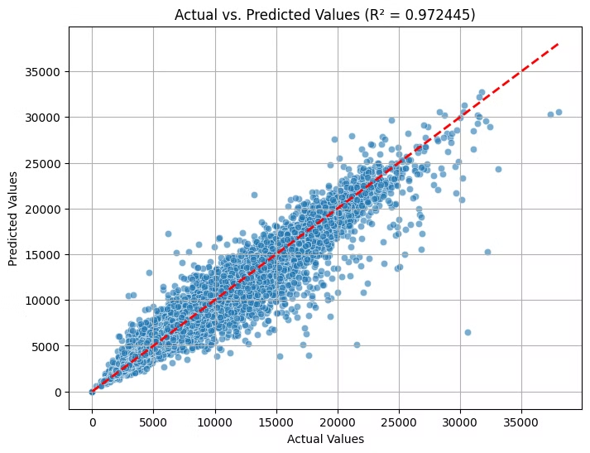
Model Evaluation
Performance Metrics
Random Forest Regressor Model
The value of R-squared calculation for Random Forest Regressor Model is '97%'.
Scatter Plot: Visualized actual vs. predicted sales values to evaluate model performance:

Slide 13

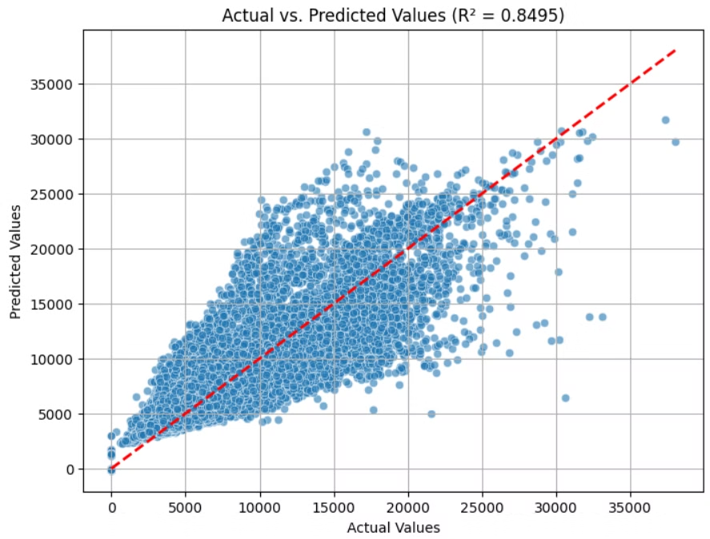
Model Evaluation
Performance Metrics
Linear Regressor Model
The value of R-squared calculation for Linear Regressor Model is '84'.

Slide 14

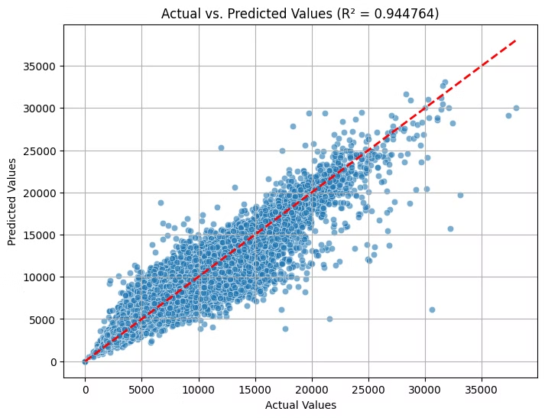
Model Evaluation
Performance Metrics
ExtraTrees regressor Model
The value of R-squared calculation for ExtraTrees regressor Model is '0.944764'.

Slide 15
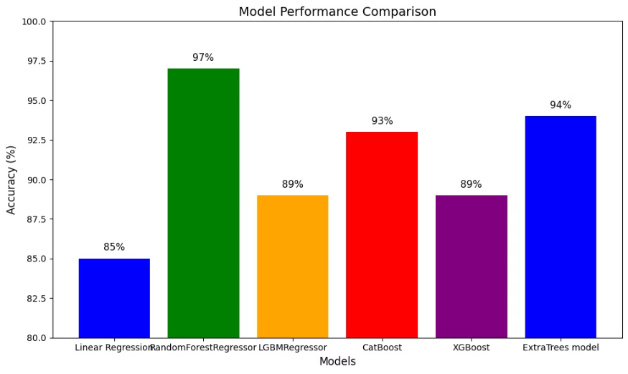
Model Comparison with Protoypes models : R2 - Squared Value

Slide 16
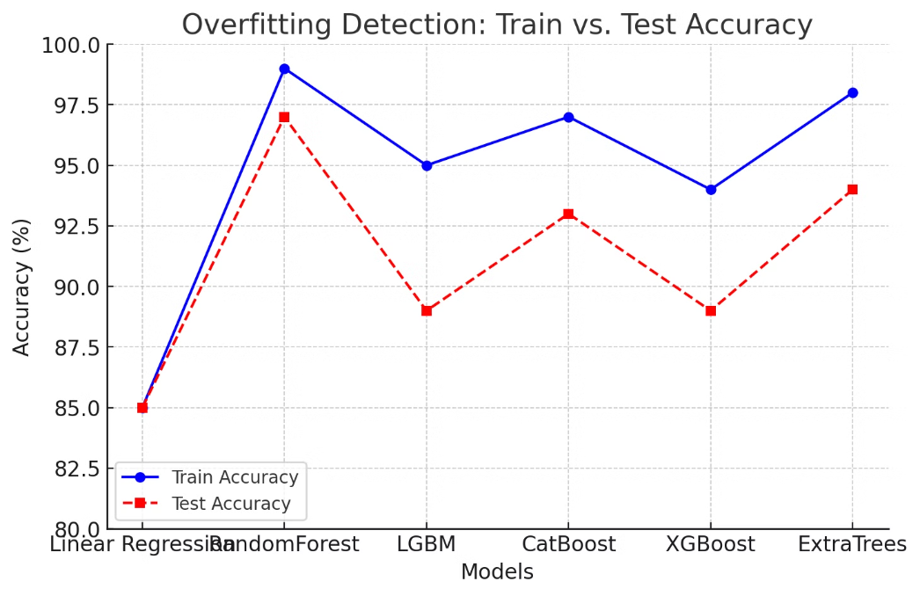
This chart visualizes overfitting by comparing training accuracy and test accuracy across different models.

Slide 17
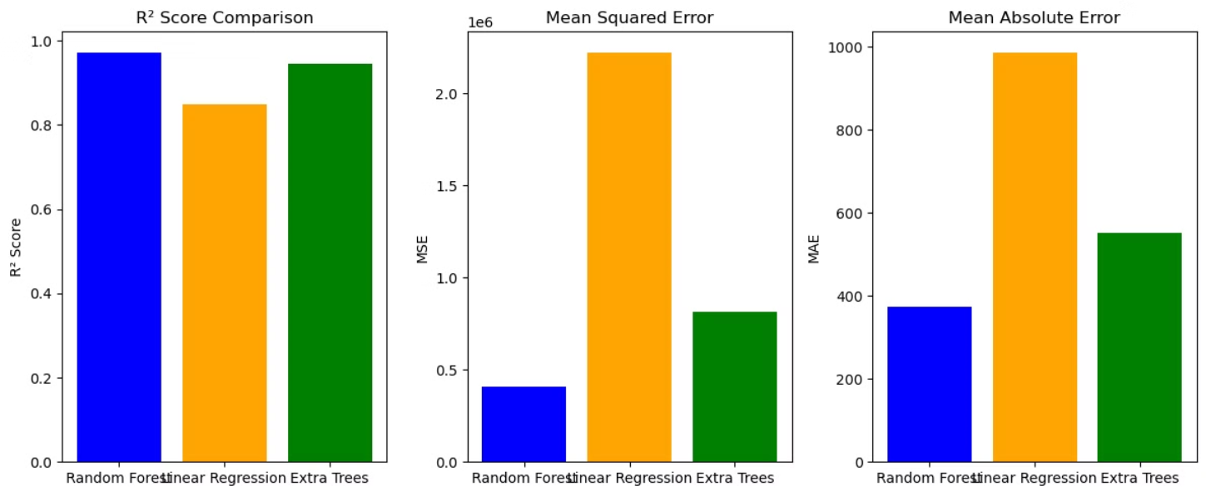
is visualization compares the performance of three regression models—Random Forest, Linear Regression, and Extra Trees—using three evaluation metrics:

Slide 18
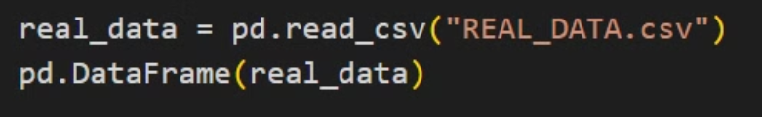
Real_Data file:
1
Data Preprocessing:
We started by loading the dataset using Pandas
2
Data cleaning

Slide 19

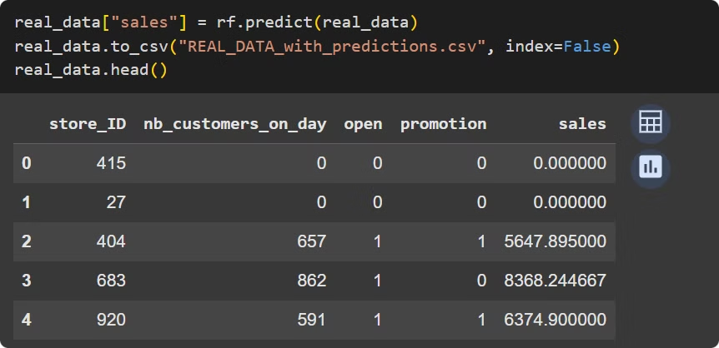
Predict sales using the Random Forest regressor model

Slide 20

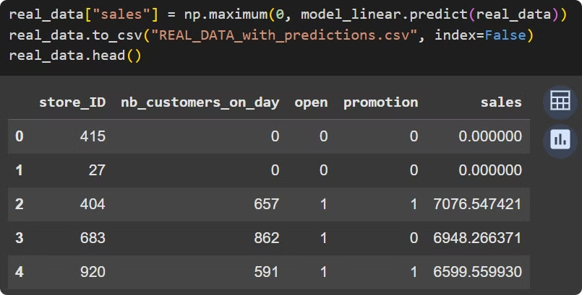
Predict sales using the Linear model

Slide 21

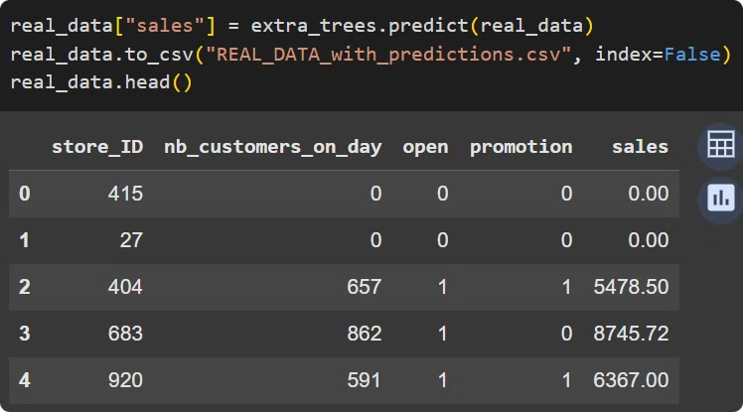
Predict sales using the ExtraTrees model

Slide 22

Best Performance Metrics - RandomForest Model - Detailed Steps
Our final model choice is RandomForest Model because it achieves the best balance between accuracy and generalization.
374
407303
0.97
MAE
MSE
R²
Mean Absolute Error.
Mean Square Error.
R-squared value.

Slide 23

Thank You!
Any Q&A feel free to reach out Group 2!

